Slide 1
A Man with a Rash and “Pink Eye”
STD Case Studies from the Denver Metro Health Clinic

Slide 2
Case
45 year-old HIV+ gay male, presented to the STD clinic as a contact to gonorrhea
Generalized rash since 6 weeks
Discontinued HIV medication 5 weeks prior
CD4 count dropped from >1,000 to 460/mm3
Rash did not resolve
“Pink Eye” since 1 week, predominantly right-sided
Pain
Blurry vision

Slide 3
Sexual and STI History
Committed relationship with HIV+ partner
Occasional oral/anal sex with incidental partners, mostly protected
Last contact: 2 weeks ago
History of primary syphilis 4 years ago
Treated with 2.4 MU LAB at this clinic
Last RPR: NR (12 months ago)

Slide 4
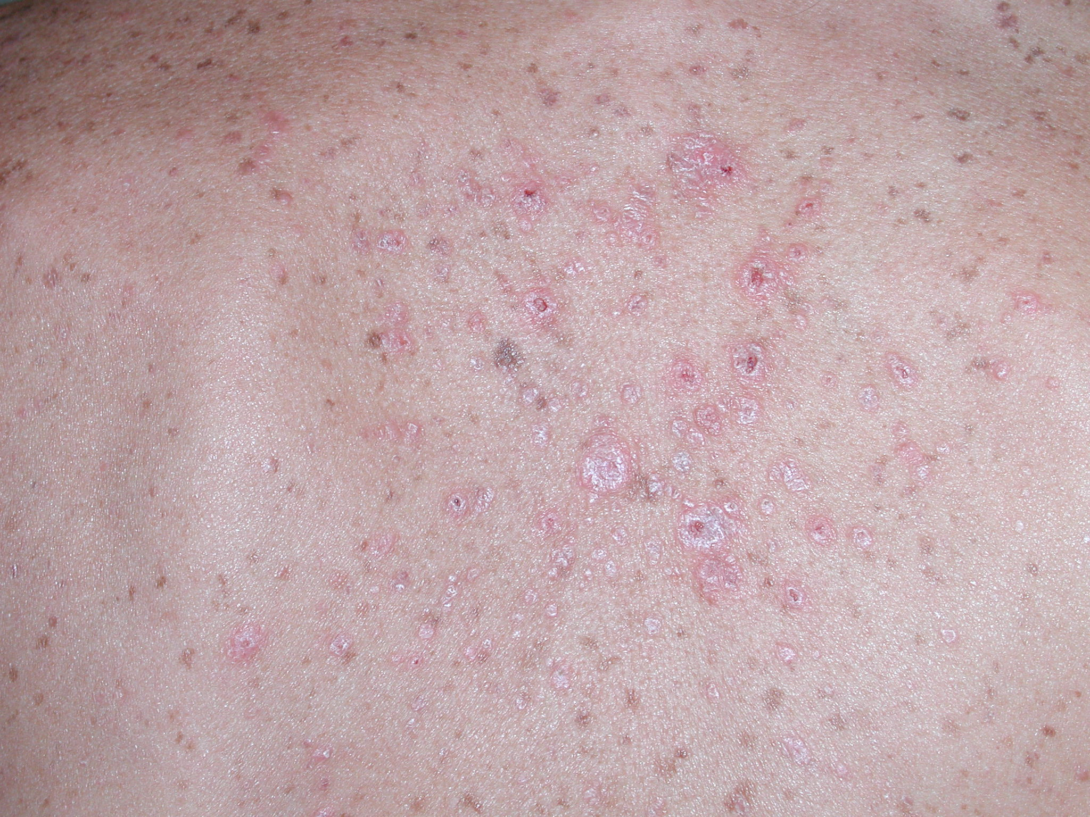

Slide 5
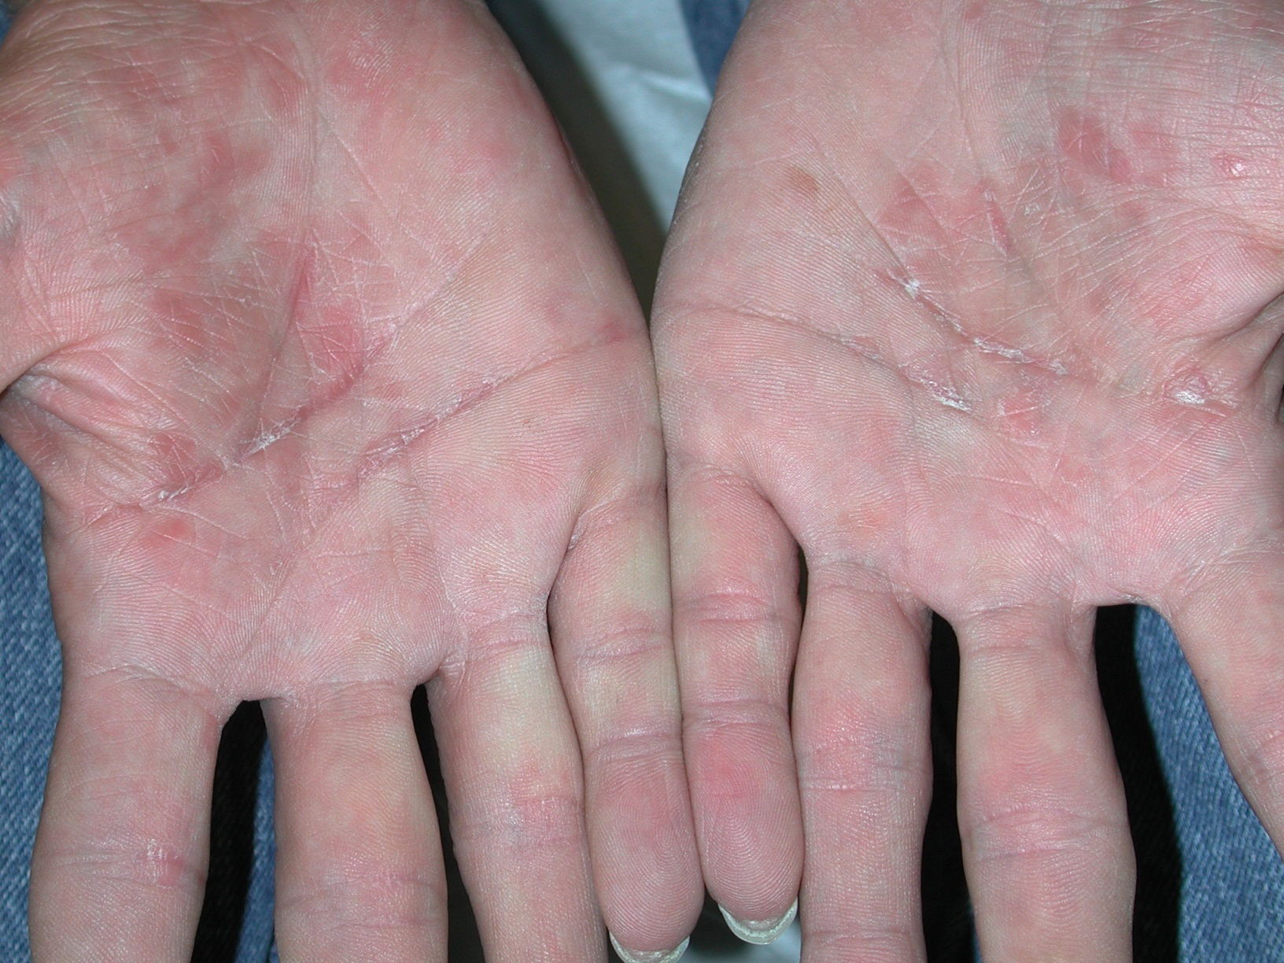

Slide 6
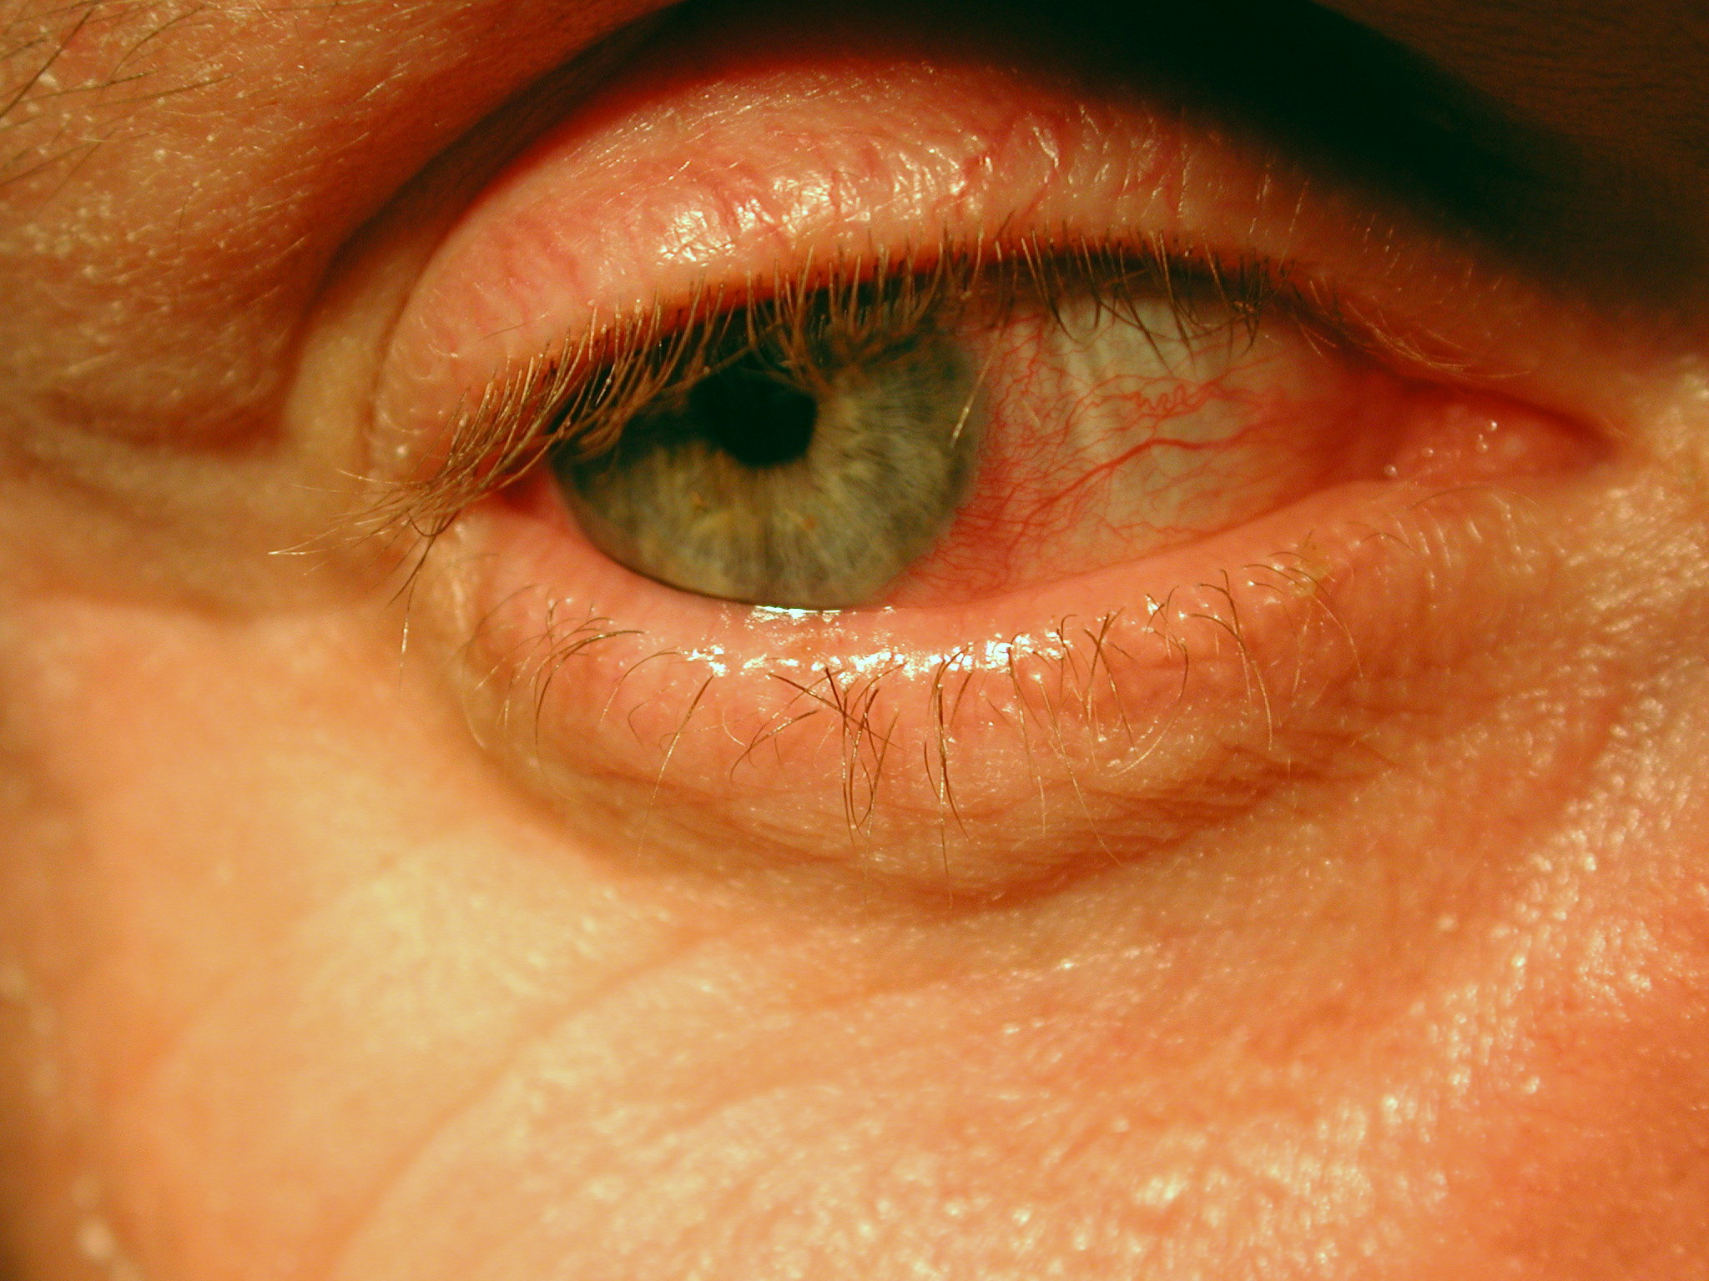
Note: “ciliary flush” around the edge of the cornea

Slide 7
In evaluating this patient, what is the LEAST useful?
Neurologic examination
Quantitative non-treponemal test (RPR/VDRL)
Treponemal test (TPPA, FTA-ABS)
Lumbar puncture
Refer to opthalmologist

Slide 8
Results
RPR: reactive at 1:256
TPPA: positive
LP: VDRL 1:1; 70 WBC
Opthalmic examination: anterior uveitis

Slide 9
What is the likely diagnosis?
Primary syphilis
Secondary syphilis
Tertiary syphilis
Neurosyphilis
1 and 4
2 and 4

Slide 10
How should this patient be treated?
Per CDC guidelines for secondary syphilis: singe dose of 2.4 million units of benzathine penicillin i.m.
Per CDC guidelines for syphilis with uveitis and HIV infection: 2.4 million unites of benzathine penicillin i.m. once a week for 3 weeks
Per CDC guidelines for neurosyphilis: aqueous crystalline penicillin G 18-24 million unites per day for 10-14 days.

Slide 11
Disclaimer
Copyright case study and clinical photos:
Dr. Kees Rietmeijer, STD Control Program, Denver Public Health Department
Individual slides can be used for educational purposes with reference to source and/or inclusion of the DMHC logo

